Slide 1
Membership Benefits

Slide 2
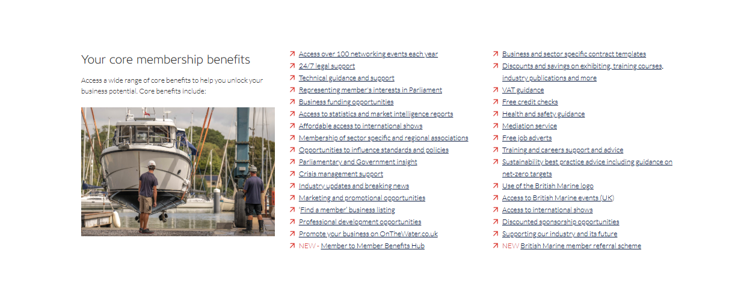
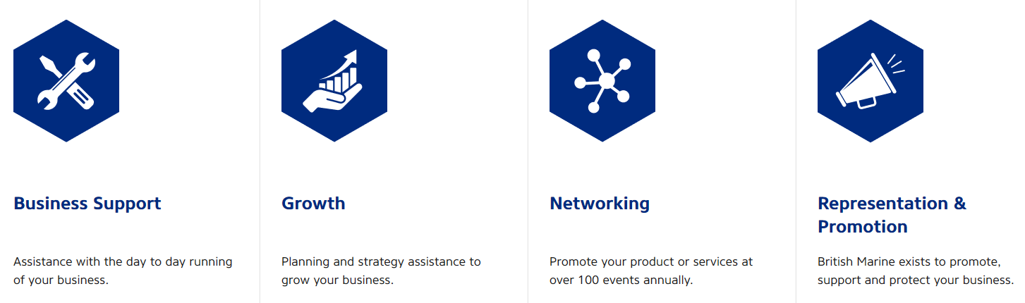
Why Become a Member?
https://www.britishmarine.co.uk/membership

Slide 3
Business Support
Technical guidance and support
24/7 legal support
Crisis management support
Industry updates and breaking news
Member to Member Benefits Hub
Business and sector specific contract templates
Discounts and savings on exhibiting, training courses,
industry publications and more
VAT guidance
Free credit checks
Health and safety guidance
Mediation service
Free job adverts
Sustainability best practice advice including guidance on net-zero targets

Slide 4
Growth
Business funding opportunities
Access to statistics and market intelligence reports
Affordable access to international shows
Marketing and promotional opportunities
Professional development opportunities
Training and careers support and advice
Access to international shows
Discounted sponsorship opportunities

Slide 5
Networking
Access over 100 networking events each year
Membership of sector specific and regional associations
‘Find a member’ business listing
Use of the British Marine logo
Access to British Marine events (UK)
Access to international shows
British Marine member referral scheme

Slide 6
Representation and Promotion
Representing member's interests in Parliament
Opportunities to influence standards and policies
Parliamentary and Government insight
Supporting our industry and its future

Slide 7
Sector Associations
British Marine Association | Supported Sector
British Marine Access to Boating Association | Sailing schools and coastal charter
British Marine Boat Retailers and Brokers | Boat retail and brokerage
British Marine Boatbuilders Association | Boatbuilding (<24m)
British Marine Electrical and Electronics | Electrical and electronics supply, maintenance and installation
British Marine Inland Boating | Inland boating, boatbuilding and hire
British Marine Professional Services Association | Legal, financial, insurance services
British Marine Propulsion and Equipment | Engines and equipment supply, maintenance and installation
British Marine Trades Association | Leisure marine trade and supply chain
Broads Hire Boat Federation | Norfolk Broads boat hire
Commercial Marine | Commercial boat building and supply chain (<24m)
Passenger Boat Association | Passenger boat operation
Superyacht UK | Superyacht inc. supply chain
The Yacht Harbour Association | Yacht harbours, marinas & supply chain
Notes:
Associations are split into regions and groups.

Slide 8
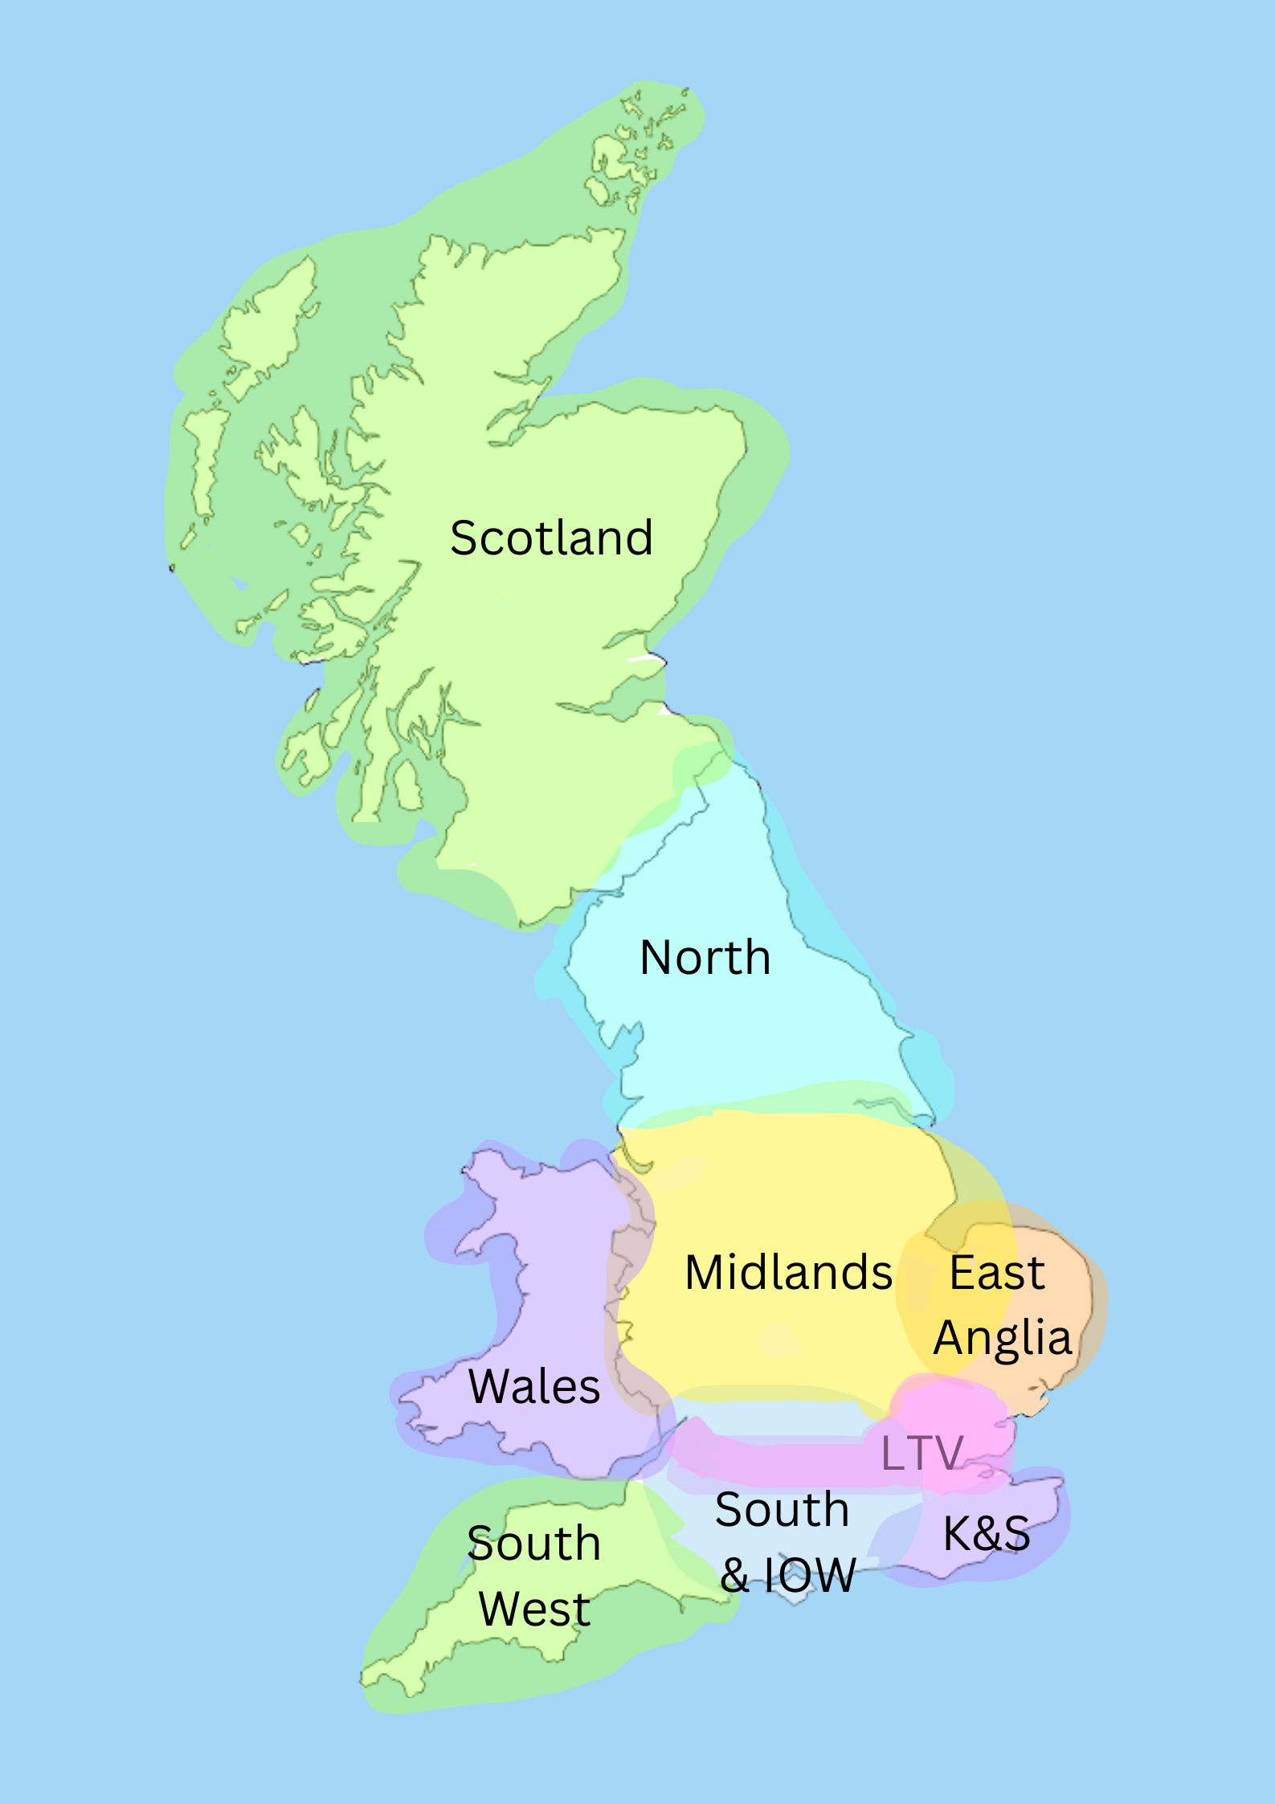
Regional Associations
British Marine East Anglia
British Marine Kent and Sussex
British Marine London & Thames Valley
British Marine Midlands
British Marine North
British Marine Scotland
British Marine South and Isle of Wight
British Marine South West
British Marine Wales

Slide 9
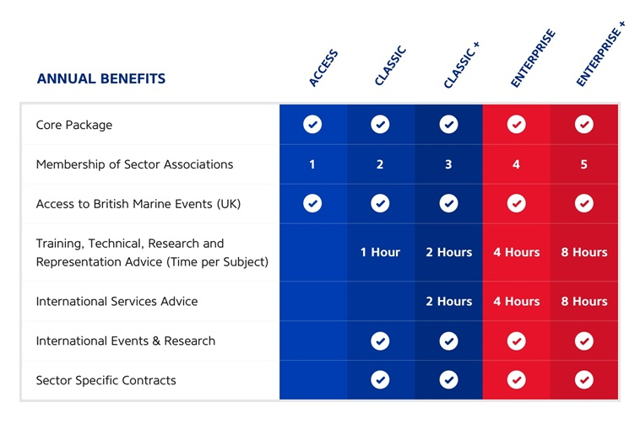
Our Membership
Depending on the membership package that members have subscribed to, amongst other factors, they have the option to join several associations as relevant to the nature of their business.
Notes:
Depending on the membership package that members have subscribed to, amongst other factors, they have the option to join several associations as relevant to the nature of their business.

Slide 10
Questions?

